Slide 1







Enterprise Blockchain Developers (Intermediate)
In support of
Powered By

Slide 2
Outline
node templates
passing parameters to the view
Forms
Middleware
API vs Non API
JWT
File Upload
© 2017-2020 SmartMesh Foundation Pte. Ltd. | MeshBox Foundation Pte. Ltd.

Slide 3
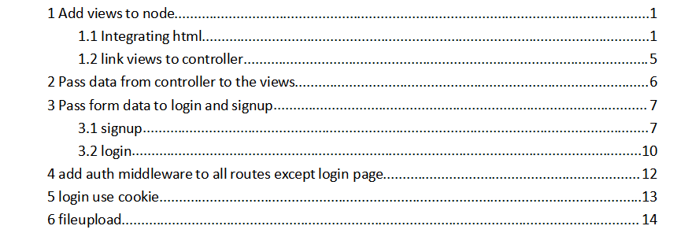
Outline
© 2017-2020 SmartMesh Foundation Pte. Ltd. | MeshBox Foundation Pte. Ltd.

Slide 4
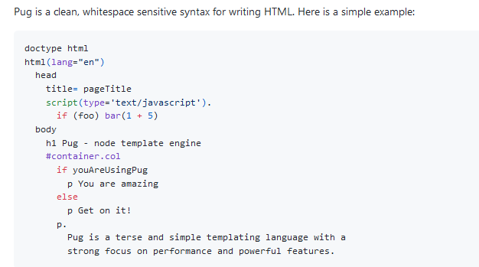
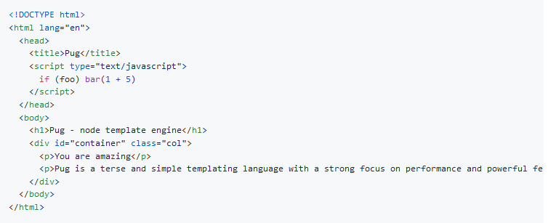
Views: Templates
Pug formly named Jade

Slide 5
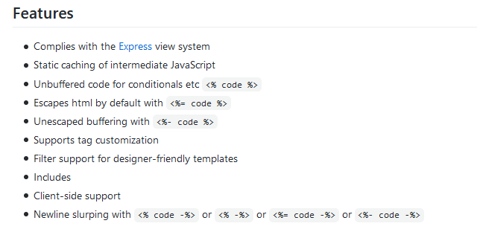
Views: Templates
EJS: html + code https://github.com/tj/ejs

Slide 6
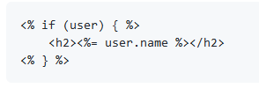
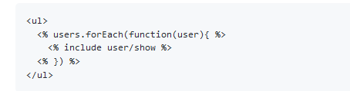
Views: Templates
1 if statement
2 EJS: includes
makeing html managable

Slide 7
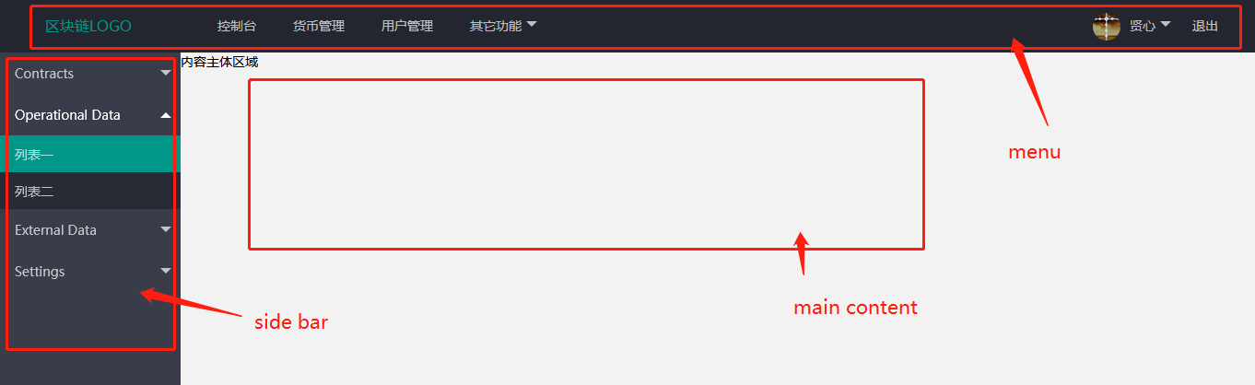
Views: Templates
How to design your templates?
1 draw a wireframe,
2 define the layout
3 write each part to a component

Slide 8
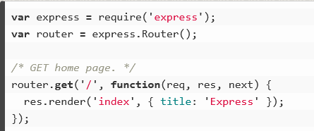
Views: Pass Parameters down to the View
Code Demo: pass params
Code Demo: check login logic

Slide 9
Views: Pass Parameters down to the View
render vs redirect
res.render() will render the view with data passed to it, res.redirect() will redirect a user to another page (at which point the request starts over)
redirect can also pass the data
res.redirect('/?valid=' + string);
res.json() vs res.send()
res.json() allows for extra formatting of the JSON data - if this is not required res.send()

Slide 10
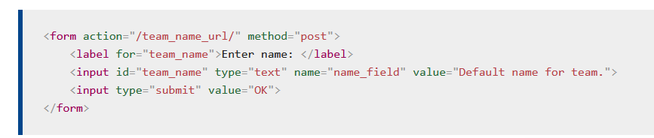
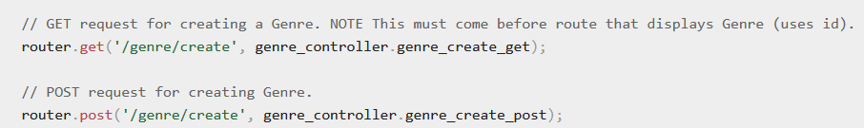
Form
1 specify Router
2 specify the request type, usually POST for Forms
Form will take inputs value as parameters to send to the controller
action should match routes, then the route will call the controller function to handle the request. In this case, put action = /genre/create

Slide 11
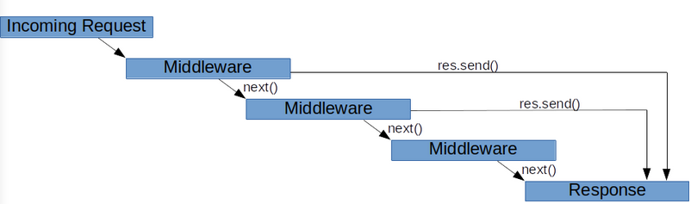
Middleware
demo auth middleware

Slide 12
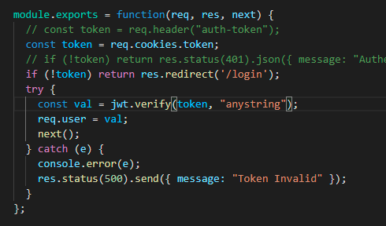
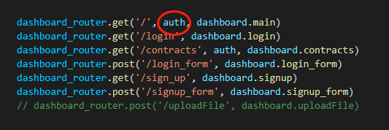
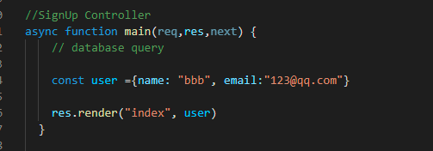
Middleware
demo auth middleware

Slide 13
API vs Non API Application
API doesn't have to pass the params to the view
view coud be written separately
view use js to parse the data
Compare it with an non api program
Data is proccessed in controller and passed down to the view
but view and program cannot be separated
API
controller
enternal application
request
views
model
non API

Slide 14
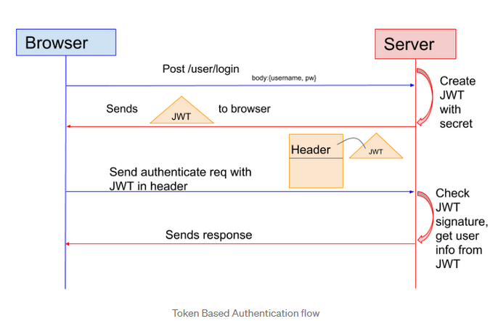
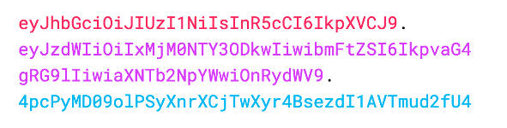
JsonWebToken(JWT)
What is JWT

Slide 15
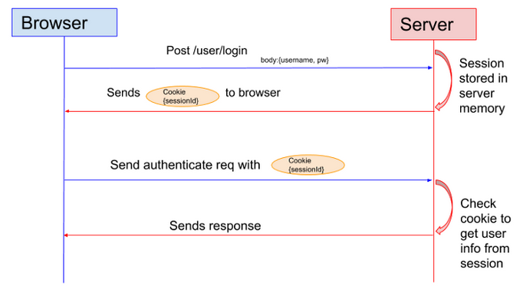
JsonWebToken(JWT)
JWT vs Session
Drawback: the Session cannot be verified cross servers for the cluster, unless stored in database

Slide 16
JsonWebToken(JWT)
get the token from api
1. store it in cookie (demo this method)
2. store it in localstore
Difference
Local Storage
Pros: It's convenient.
Cons: It's vulnerable to XSS attacks.
Cookies
Pros: The cookie is not accessible via JavaScript; hence, it is not as vulnerable to XSS attacks as localStorage.
Cons: Depending on the use case, you might not be able to store your tokens in the cookies. For Instance: Cookies have a size limit of 4KB.

Slide 17
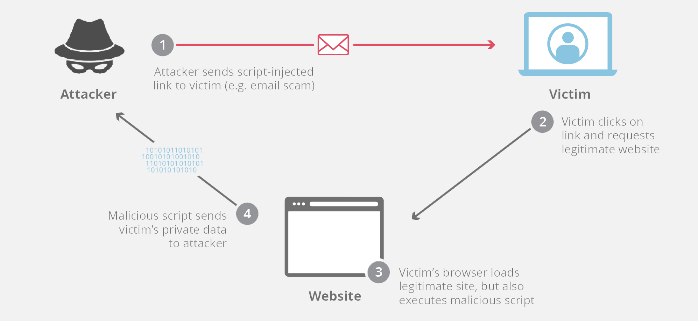
JsonWebToken(JWT)
XXS attack

Slide 18
File Upload
localhost (code demo)
https://www.geeksforgeeks.org/file-uploading-in-node-js/
ipfs (code demo)
https://docs.ipfs.io/install/ipfs-desktop/#windows
https://medium.com/better-programming/how-to-get-started-with-ipfs-and-node-fa04baec6b3a

